Slide 1

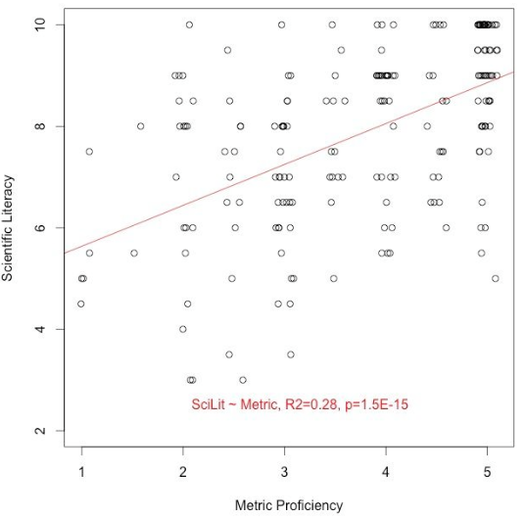
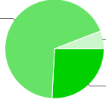
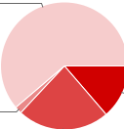
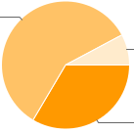
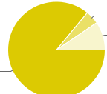
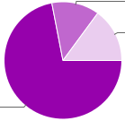
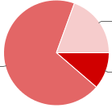
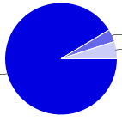
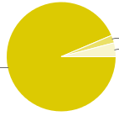
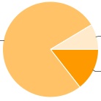
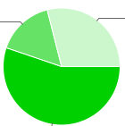
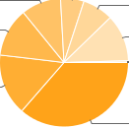
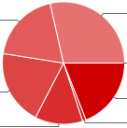
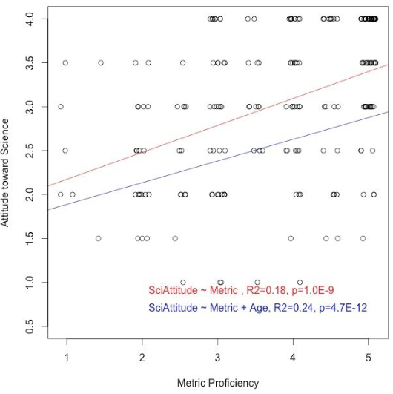
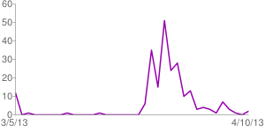
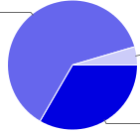
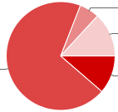
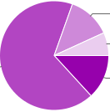
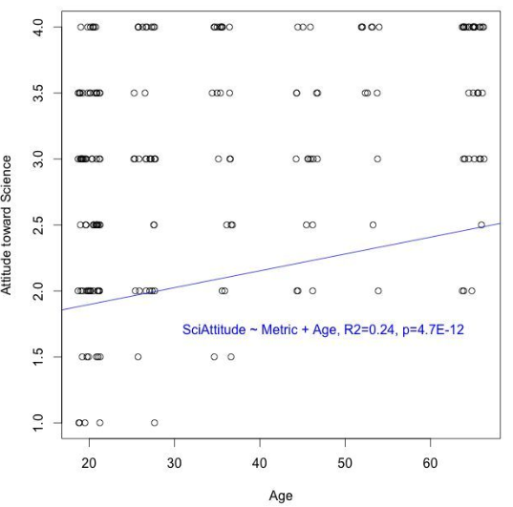
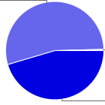
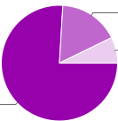
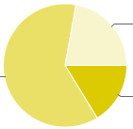
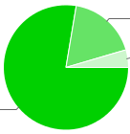
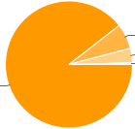
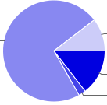
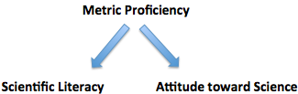
The influence of metric proficiency on scientific literacy and acceptance of science Alannah Mack¹, Anique Thompson¹, Kasha Price¹, Kofi Khamit-Kush² , Hong Qin¹ ¹ Biology Department, Spelman College ² Psychology Department, Morehouse College, Atlanta, GA 30314, U.S.A.
Abstract
The daily life in the U.S.A. is based on customary units separated from the international systems of units (metric system) that are taught in sciences. Does this partition of daily life and scientific understanding hinder the scientific literacy for the American population and impose a negative connotation on science as a whole? These are the questions that we set to investigate. We designed a survey to gauge people’s scientific literacy and acceptance of scientific findings, while taking into account confounding factors such as educational background, gender, country, and age etc. The survey contains 3 sets of problems: one set on proficiency of the metric system, one set on scientific literacy, and one set on attitude and acceptance toward science. By administering an online survey, we try to reach out to a broad population worldwide, thereby enable us to compare the U.S.A. population with people living in other countries. We will analyze the survey results quantitatively using regression method. The implication of this study could have profound impacts on the education systems and daily life in the U.S.A.
Hypothesis
Regression Results
The partition of daily life and science in USA may hinder our understanding and acceptance of science?
Survey Summary
1) Antibiotics 2) Metric conversion 3) Religion/Science 4) Earth center 5) Continents 6) Dinosaurs
1) Technology 2) Electrons/Atoms 3) Lasers and Sound 4) Inseam 5) Age Group 6) Highest Education
Methods
We will design a survey to investigate the association of people’s ability to interpret metric units, their scientific literacy, and their attitude toward science. These three factors will be addressed by several questions, and their statistical associations will be evaluated.
We will design a survey to investigate the association of people’s ability to interpret metric units, their scientific literacy, and their attitude toward science. These three factors will be addressed by several questions, and their statistical associations will be evaluated.
The survey will take approximately ten minutes to complete. Survey respondents will not be compensated. And, survey participants will incur no risks by participating. Survey results will be analyzed using in the R statistical language and environment.
The survey will take approximately ten minutes to complete. Survey respondents will not be compensated. And, survey participants will incur no risks by participating. Survey results will be analyzed using in the R statistical language and environment.
1) Daily Responses 2) Gender 3) Height 4) Organic Foods
1) Fossils 2) Daily Life 3) Temperature in Celsius 4) Light in Physics 5) Metric vernacular 6) Electrons
References
1) Champagne, A. Newell, S. Directions for research and development: alternative methods of assessing scientific literacy. Journal of Research in Science Teaching, 29 (8), 1992.
2) Impey, C., Buxner, S., Antonellis, J. Johnson, E., King, C., A twenty-year survey of science literacy among college undergraduates. Journal of College Science Teaching, 40 (4), 2011.
3) Delgado, Cesar. Units of length: a notational system for conceptual understanding of size an
Conclusions

Slide 2
The influence of metric proficiency on scientific literacy and acceptance of science Alannah Mack¹, Anique Thompson¹, Kasha Price¹, Kofi Khamit-Kush² , Hong Qin¹ ¹ Biology Department, Spelman College ² Psychology Department, Morehouse College, Atlanta, GA 30314, U.S.A.
Abstract
The daily life in the U.S.A. is based on customary units separated from the international systems of units (metric system) that are taught in sciences. Does this partition of daily life and scientific understanding hinder the scientific literacy for the American population and impose a negative connotation on science as a whole? These are the questions that we set to investigate. We designed a survey to gauge people’s scientific literacy and acceptance of scientific findings, while taking into account confounding factors such as educational background, gender, country, and age etc. The survey contains 3 sets of problems: one set on proficiency of the metric system, one set on scientific literacy, and one set on attitude and acceptance toward science. By administering an online survey, we try to reach out to a broad population worldwide, thereby enable us to compare the U.S.A. population with people living in other countries. We will analyze the survey results quantitatively using regression method. The implication of this study could have profound impacts on the education systems and daily life in the U.S.A.
Methods & Results
We will design a survey to investigate the association of people’s ability to interpret metric units, their scientific literacy, and their attitude toward science. These three factors will be addressed by several questions, and their statistical associations will be evaluated.
We will design a survey to investigate the association of people’s ability to interpret metric units, their scientific literacy, and their attitude toward science. These three factors will be addressed by several questions, and their statistical associations will be evaluated.
The survey will take approximately ten minutes to complete. Survey respondents will not be compensated. And, survey participants will incur no risks by participating. Survey results will be analyzed using in the R statistical language and environment.
The survey will take approximately ten minutes to complete. Survey respondents will not be compensated. And, survey participants will incur no risks by participating. Survey results will be analyzed using in the R statistical language and environment.
Results
Figures: Survey Summary
1) Antibiotics 2) Metric conversion 3) Religion/Science 4) Earth center 5) Continents 6) Dinosaurs
Conclusions
1) Technology 2) Electrons/Atoms 3) Lasers and Sound 4) Inseam 5) Age Group 6) Highest Education
References
1) Champagne, A. Newell, S. Directions for research and development: alternative methods of assessing scientific literacy. Journal of Research in Science Teaching, 29 (8), 1992.
2) Impey, C., Buxner, S., Antonellis, J. Johnson, E., King, C., A twenty-year survey of science literacy among college undergraduates. Journal of College Science Teaching, 40 (4), 2011.
3) Delgado, Cesar. Units of length: a notational system for conceptual understanding of size an
1) Daily Responses 2) Gender 3) Height 4) Organic Foods
1) Fossils 2) Daily Life 3) Temperature in Celsius 4) Light in Physics 5) Metric vernacular 6) Electrons

